Slide 1


Titanic Survival Prediction Using Deep Learning
This presentation summarizes a deep learning project that predicts Titanic passenger survival using historical data.
by Hamza Boulahia

Slide 2

Project Overview
Goal
Data
Predict Titanic passenger survival using an Artificial Neural Network (ANN).
Train the model using historical Titanic data.
Classification
Classify passengers as Survived (1) or Not Survived (0).

Slide 3
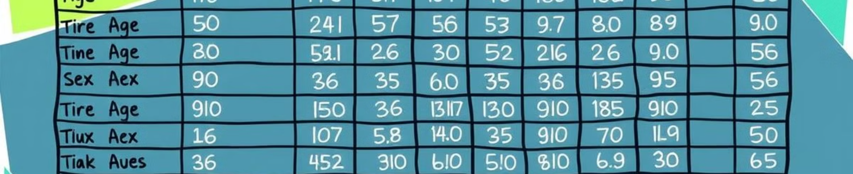
Dataset Description
Source
Titanic dataset (titanic.csv)
Key Features
Pclass, Sex, Age, Fare, Embarked

Slide 4
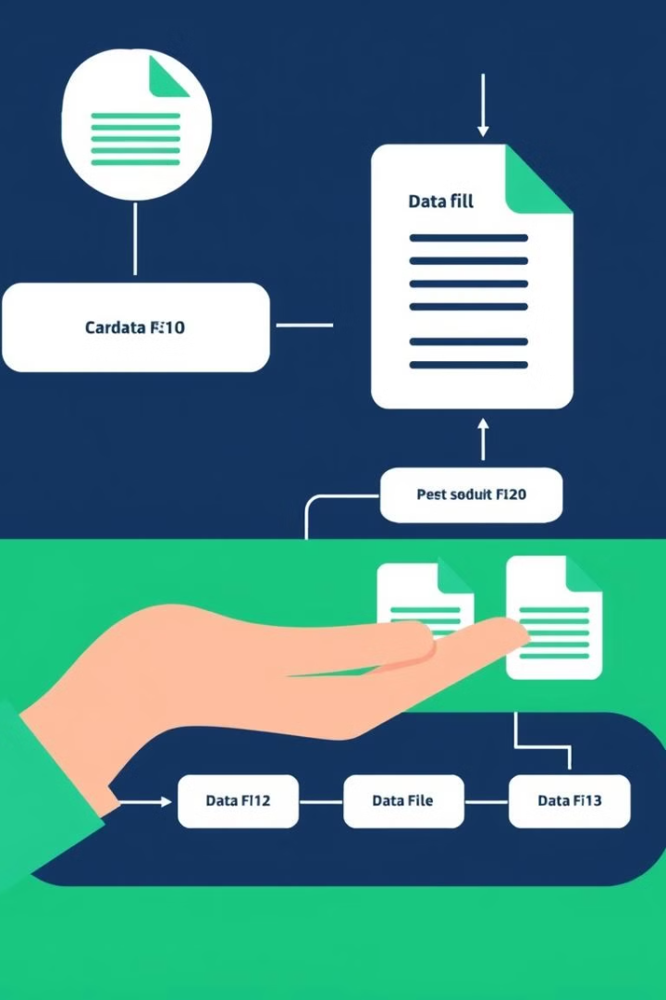
Data Preprocessing
Handling Missing Values
Address missing values in Age, Fare, and Embarked.
Encoding Categorical Variables
Convert Sex to numerical values (Male = 1, Female = 0).
Feature Scaling
Normalize Age and Fare for the ANN.
Train-Test Split
Divide data into 70% Train, 20% Validation, 10% Test.

Slide 5
Model Architecture
Input Layer
Hidden Layers
Output Layer
5 features: Pclass, Sex, Age, Fare, Embarked.
3 layers with ReLU activation: 16, 8, and 4 neurons.
1 neuron with Sigmoid activation for survival prediction.

Slide 6

Model Training & Hyperparameters
Loss Function
Binary Crossentropy (binary\_crossentropy).
Optimizer
Adam (adam).
Batch Size
32.
Epochs
50.

Slide 7

Model Evaluation
X.XX%
Accuracy
Final test accuracy.

Slide 8

Key Takeaways
Deep Learning
Data Preprocessing
Model Evaluation
Deep learning can be used to predict Titanic passenger survival.
Proper data preprocessing is crucial for model performance.
Evaluate model performance using metrics like accuracy and confusion matrix.

Slide 9
Future Work
Feature Engineering
Model Optimization
Explore additional features for improved prediction.
Fine-tune hyperparameters and experiment with different architectures.

Slide 10

Conclusion
This project demonstrated the effectiveness of deep learning for predicting Titanic passenger survival. Future work can focus on improving model performance and exploring additional features.

